Slide 1


Green Pace
Security Policy Presentation
Developer: Mahdi Bigdely

Slide 2

OVERVIEW: DEFENSE IN DEPTH
This security policy serves the purpose of ensuring the consistent implementation of secure principles across all software development activities. It covers core security principles, C/C++ coding standards, authorization, authentication, auditing standards, and data encryption standards. This policy is needed to establish a uniform and secure approach to software development, ensuring that consistent methodologies are applied and maintained over time.
Notes:
Narration version: This security policy makes sure secure practices are always used in software development. It includes rules for coding, authorization, authentication, auditing, and data encryption. The policy is necessary to have a consistent and secure way of developing software, making sure the same methods are used over time.
The security policy at Green Pace serves the purpose of ensuring the consistent implementation of secure principles across all software development activities. It covers core security principles, C/C++ coding standards, authorization, authentication, auditing standards, and data encryption standards. This policy is needed to establish a uniform and secure approach to software development, ensuring that consistent methodologies are applied and maintained over time.
The policy's scope extends to all staff involved in creating, deploying, or supporting custom software at Green Pace. It was implemented to address the increasing need for security measures in software development, safeguarding against potential vulnerabilities, unauthorized access, and data breaches.
This security policy aligns with the defense-in-depth best practice, as it establishes multiple layers of security measures. By defining and implementing core security principles, coding standards, and encryption standards, the policy builds a robust defense strategy. This multi-layered approach enhances the overall security posture, ensuring that security measures are consistently applied at various stages of the software development lifecycle. This defense-in-depth strategy is crucial in protecting Green Pace's software assets and sensitive data from diverse threats and vulnerabilities.

Slide 3
THREATS MATRIX
Evaluating the impact of specific Secure Coding standards involves assessing vulnerability levels. This chart provides a prioritized overview of these levels.
Rule | Severity | Likelihood | Remediation Cost | Priority | Level
STD-001-CPP | High | Probable | Medium | P12 | L1
STD-002-CPP | Low | Unlikely | Low | P3 | L3
STD-003-CPP | Low | Unlikely | Meduim | P3 | L3
STD-004-CPP | Low | Unlikely | Meduim | P2 | L3
STD-005-CPP | Low | Probable | Low | P6 | L2
STD-006-CPP | Low | Unlikely | High | P1 | L3
STD-007-CPP | Low | Unlikely | Meduim | P3 | L3
STD-008-CPP | Meduim | Unlikely | Meduim | P4 | L3
STD-009-CPP | High | Unlikely | High | P3 | L3
STD-0010-CPP | High | Unlikely | Medium | P6 | L12

Slide 4
10 PRINCIPLES
Validate Input Data: Ensuring a robust input data validation mechanism is crucial for preventing potential vulnerabilities within a system. Thoroughly validating incoming data from both trusted and untrusted sources proactively safeguards against malicious data, enhancing overall system security.
Heed Compiler Warnings: Diligently compiling and testing code, while paying attention to compiler warnings, is essential for maintaining optimal efficiency and identifying potential issues. Addressing all warnings meticulously ensures a robust and error-free codebase, contributing to overall code reliability.
Architect and Design for Security Policies: Integrating security considerations into the design phase establishes a strong foundation, reducing the need for extensive adjustments later. This proactive approach enhances system security and contributes to the efficiency of the development lifecycle.
Keep It Simple: Adhering to simplicity in code streamlines development, improves code readability, and reduces the system's complexity, minimizing security risks. Clean and straightforward code facilitates effective identification of vulnerabilities and implementation of protective measures.
Default Deny: Advocating for denying access by default and allowing only explicitly approved actions, this principle minimizes the attack surface, promotes explicit authorization, and enhances overall security posture through the principle of least privilege.
Adhere to the Principle of Least Privilege: Restricting access rights to the minimum necessary reduces the potential impact of security breaches and limits the attack surface. Operating with the least amount of authority needed enhances system security by preventing unauthorized access and potential misuse.
Sanitize Data Sent to Other Systems: Thoroughly validating and cleansing data before transmitting it to external systems prevents vulnerabilities and potential exploits. Rigorous data sanitization practices mitigate the risk of providing harmful input, reducing the likelihood of security breaches.
Practice Defense in Depth: Implementing multiple layers of security measures, including technical, procedural, and physical safeguards, creates a resilient defense strategy. Diversifying security measures mitigates the impact of potential breaches and enhances overall system resilience.
Use Effective Quality Assurance Techniques: Integrating robust quality assurance practices throughout the software development lifecycle, including code reviews and comprehensive testing, helps identify and rectify security issues early, minimizing the likelihood of deploying insecure code.
Adopt a Secure Coding Standard: Implementing and following secure coding practices, as outlined in standardized guidelines, enhances overall software security. Adhering to these standards facilitates early identification and resolution of security issues, contributing to a more secure codebase.
Notes:
Narration version:
Validate Input Data: Check information from all sources to keep the system safe.
Heed Compiler Warnings: Listen to warnings when writing code to avoid potential issues.
Architect and Design for Security Policies: Plan security measures from the start to save time later.
Keep It Simple: Write code that is easy to understand to avoid mistakes.
Default Deny: Only allow actions that are explicitly approved to reduce risks.
Adhere to the Principle of Least Privilege: Give the minimum access needed to do a job to limit potential harm.
Sanitize Data Sent to Other Systems: Check and clean data before sharing it with other systems.
Practice Defense in Depth: Use multiple layers of security to protect against different threats.
Use Effective Quality Assurance Techniques: Test code to find and fix security issues early.
Adopt a Secure Coding Standard: Follow established guidelines to create secure software.
Long Version:
Validate Input Data: Ensuring a robust input data validation mechanism is crucial for preventing potential vulnerabilities within a system. Thoroughly validating incoming data from both trusted and untrusted sources proactively safeguards against malicious data, enhancing overall system security.
Heed Compiler Warnings: Diligently compiling and testing code, while paying attention to compiler warnings, is essential for maintaining optimal efficiency and identifying potential issues. Addressing all warnings meticulously ensures a robust and error-free codebase, contributing to overall code reliability.
Architect and Design for Security Policies: Integrating security considerations into the design phase establishes a strong foundation, reducing the need for extensive adjustments later. This proactive approach enhances system security and contributes to the efficiency of the development lifecycle.
Keep It Simple: Adhering to simplicity in code streamlines development, improves code readability, and reduces the system's complexity, minimizing security risks. Clean and straightforward code facilitates effective identification of vulnerabilities and implementation of protective measures.
Default Deny: Advocating for denying access by default and allowing only explicitly approved actions, this principle minimizes the attack surface, promotes explicit authorization, and enhances overall security posture through the principle of least privilege.
Adhere to the Principle of Least Privilege: Restricting access rights to the minimum necessary reduces the potential impact of security breaches and limits the attack surface. Operating with the least amount of authority needed enhances system security by preventing unauthorized access and potential misuse.
Sanitize Data Sent to Other Systems: Thoroughly validating and cleansing data before transmitting it to external systems prevents vulnerabilities and potential exploits. Rigorous data sanitization practices mitigate the risk of providing harmful input, reducing the likelihood of security breaches.
Practice Defense in Depth: Implementing multiple layers of security measures, including technical, procedural, and physical safeguards, creates a resilient defense strategy. Diversifying security measures mitigates the impact of potential breaches and enhances overall system resilience.
Use Effective Quality Assurance Techniques: Integrating robust quality assurance practices throughout the software development lifecycle, including code reviews and comprehensive testing, helps identify and rectify security issues early, minimizing the likelihood of deploying insecure code.
Adopt a Secure Coding Standard: Implementing and following secure coding practices, as outlined in standardized guidelines, enhances overall software security. Adhering to these standards facilitates early identification and resolution of security issues, contributing to a more secure codebase.

Slide 5
CODING STANDARDS
The SEI CERT C++ Coding Standard [STD-001-CPP] Rule DCL50-CPP discourages the use of C-style variadic functions in C++ code due to their potential hazards. Instead, it recommends employing safer alternatives like function parameter packs or function currying to maintain type safety and prevent security vulnerabilities.
Rule DCL51-CPP in the SEI CERT C++ Coding Standard [STD-002-CPP] cautions against declaring or defining reserved identifiers, following the C++ Standard [ISO/IEC 14882-2014]. Violations, like declaring identifiers in reserved contexts, result in undefined behavior.
Rule DCL52-CPP in SEI CERT C++ Standard [STD-003-CPP] advises against const or volatile qualification of reference types. C++ inherently treats references as const, and trying to const-qualify them can lead to unintended issues, causing undefined behavior. Conforming compilers are expected to issue diagnostic messages for such cases.
Rule DCL53-CPP in SEI CERT C++ Standard [STD-004-CPP] advises against syntactically ambiguous declarations to prevent vexing parse situations. To resolve ambiguity, consider any construct that might be a declaration as one. Alternatives like uniform initialization, nonfunction-style casts, initializing with '=', or removing extraneous parentheses are recommended.
Rule DCL54-CPP in SEI CERT C++ Standard [STD-005-CPP] advises pairing overloaded allocation and deallocation functions within the same scope to prevent violations of other rules, such as MEM51-CPP. Overloading ensures proper handling of dynamically allocated resources. For instance, if an allocation function uses a private heap, passing its pointer to the default deallocation function may lead to undefined behavior. Providing a definition for deleted allocation or deallocation functions within a class member function is discouraged to prevent unintended access.
Rule DCL55-CPP in SEI CERT C++ Standard [STD-006-CPP] warns against information leakage when passing a class object across trust boundaries. Due to potential indeterminate values in padding bits, it is essential, especially when sharing a pointer to a class object between trusted domains, to ensure these bits do not contain sensitive information, preventing unintended leaks.
Exceptions in C++ must adhere to the SEI CERT C++ Coding Standard rule ERR55-CPP, emphasizing the importance of proper exception specifications, especially in the context of terminating a destructor, operator delete, or operator delete[]. Violating this rule by throwing exceptions in deallocation functions or destructors, and using noexcept(false), is unacceptable and triggers undefined behavior. It is recommended to rely on implicit noexcept(true) or explicitly declare noexcept on the function signature to ensure well-defined behavior in C++ programs.
Rule DCL59-CPP in the SEI CERT C++ Coding Standard advises against using unnamed namespaces in header files. This practice, which creates unique namespaces with internal linkage, can lead to unexpected outcomes and violate the one-definition rule (ODR). As production-quality C++ code often uses header files for code sharing between translation units, following this guideline ensures consistent and predictable behavior while preventing surprises, reducing executable size, and avoiding potential undefined behavior.
Follow Rule DCL60-CPP in the SEI CERT C++ Coding Standard to adhere to the one-definition rule (ODR) in C++, ensuring deterministic linking. The ODR requires a single definition for each non-inline function or variable ODR-used in a program. Violating the ODR leads to undefined behavior. While common practices like using header files with declarations usually comply, caution is essential with language linkage specifications and vendor-specific extensions to prevent accidental violations, ensuring predictable program behavior.
Avoid modifying standard namespaces, particularly std and posix, as advised by Rule DCL58-CPP in the SEI CERT C++ Coding Standard. Introducing new declarations or definitions in these namespaces, except under specific circumstances, leads to undefined behavior according to the C++ Standard [ISO/IEC 14882-2014].
Notes:
Narration version: The 10 principles of secure coding are like a set of rules for writing computer programs in a way that keeps them safe and protected from bad things that could happen. They help make sure the code is strong and less likely to have problems, like letting in harmful information or being easily broken into. Following these principles is like building a sturdy and reliable fortress for your computer programs, making them more resistant to possible threats and ensuring they work well and securely.
Long version:
The SEI CERT C++ Coding Standard [STD-001-CPP] Rule DCL50-CPP discourages the use of C-style variadic functions in C++ code due to their potential hazards. Instead, it recommends employing safer alternatives like function parameter packs or function currying to maintain type safety and prevent security vulnerabilities. Declarations of C-style variadic functions without definitions are allowed in unevaluated contexts. The rule's objective is to improve code safety and maintainability in C++ programs.
Rule DCL51-CPP in the SEI CERT C++ Coding Standard [STD-002-CPP] cautions against declaring or defining reserved identifiers, following the C++ Standard [ISO/IEC 14882-2014]. Violations, like declaring identifiers in reserved contexts, result in undefined behavior. Adhering to these guidelines is crucial for code reliability and C++ Standard compliance.
Rule DCL52-CPP in SEI CERT C++ Standard [STD-003-CPP] advises against const or volatile qualification of reference types. C++ inherently treats references as const, and trying to const-qualify them can lead to unintended issues, causing undefined behavior. Conforming compilers are expected to issue diagnostic messages for such cases.
Rule DCL53-CPP in SEI CERT C++ Standard [STD-004-CPP] advises against syntactically ambiguous declarations to prevent vexing parse situations. To resolve ambiguity, consider any construct that might be a declaration as one. Alternatives like uniform initialization, nonfunction-style casts, initializing with '=', or removing extraneous parentheses are recommended.
Rule DCL54-CPP in SEI CERT C++ Standard [STD-005-CPP] advises pairing overloaded allocation and deallocation functions within the same scope to prevent violations of other rules, such as MEM51-CPP. Overloading ensures proper handling of dynamically allocated resources. For instance, if an allocation function uses a private heap, passing its pointer to the default deallocation function may lead to undefined behavior. Providing a definition for deleted allocation or deallocation functions within a class member function is discouraged to prevent unintended access.
Rule DCL55-CPP in SEI CERT C++ Standard [STD-006-CPP] warns against information leakage when passing a class object across trust boundaries. Due to potential indeterminate values in padding bits, it is essential, especially when sharing a pointer to a class object between trusted domains, to ensure these bits do not contain sensitive information, preventing unintended leaks.
Exceptions in C++ must adhere to the SEI CERT C++ Coding Standard rule ERR55-CPP, emphasizing the importance of proper exception specifications, especially in the context of terminating a destructor, operator delete, or operator delete[]. Violating this rule by throwing exceptions in deallocation functions or destructors, and using noexcept(false), is unacceptable and triggers undefined behavior. It is recommended to rely on implicit noexcept(true) or explicitly declare noexcept on the function signature to ensure well-defined behavior in C++ programs.
Rule DCL59-CPP in the SEI CERT C++ Coding Standard advises against using unnamed namespaces in header files. This practice, which creates unique namespaces with internal linkage, can lead to unexpected outcomes and violate the one-definition rule (ODR). As production-quality C++ code often uses header files for code sharing between translation units, following this guideline ensures consistent and predictable behavior while preventing surprises, reducing executable size, and avoiding potential undefined behavior.
Follow Rule DCL60-CPP in the SEI CERT C++ Coding Standard to adhere to the one-definition rule (ODR) in C++, ensuring deterministic linking. The ODR requires a single definition for each non-inline function or variable ODR-used in a program. Violating the ODR leads to undefined behavior. While common practices like using header files with declarations usually comply, caution is essential with language linkage specifications and vendor-specific extensions to prevent accidental violations, ensuring predictable program behavior.
Avoid modifying standard namespaces, particularly std and posix, as advised by Rule DCL58-CPP in the SEI CERT C++ Coding Standard. Introducing new declarations or definitions in these namespaces, except under specific circumstances, leads to undefined behavior according to the C++ Standard [ISO/IEC 14882-2014]. To maintain compatibility with standard library conventions and prevent undefined behavior, refrain from adding declarations or definitions to std or posix, or any namespace within them.

Slide 6
ENCRYPTION POLICIES
Data-at-rest encryption: involves securely encoding stored information using a symmetric encryption key, ensuring only authorized users with the decryption key can access it. This is crucial for protecting sensitive data.
Encryption in transit securely: encodes data during transmission, with the encryption method depending on the transfer method, like using secure protocols for web browsers or encrypting email content.
Encrypting data in use: protects information in memory, achieved through password-protected profiles to secure user-associated memory, preventing the compromise of stored data.
Notes:
Narration version: Data encryption is like putting your information in a secret code that only those with the right key can understand. It keeps your data safe and private, protecting it from unauthorized access or use.
Long Version:
Data-at-rest encryption involves securely encoding stored information using a symmetric encryption key, ensuring only authorized users with the decryption key can access it. This is crucial for protecting sensitive data. Encryption in transit securely encodes data during transmission, with the encryption method depending on the transfer method, like using secure protocols for web browsers or encrypting email content. Encrypting data in use protects information in memory, achieved through password-protected profiles to secure user-associated memory, preventing the compromise of stored data.

Slide 7
TRIPLE-A POLICIES
Authentication verifies a user's identity through credentials like usernames and passwords, with additional security measures such as secure tokens, two-step verification, PINs, and hardware credentials for enhanced protection.
Authorization: user is authorized with specific permissions to access various parts of the system, roles, or perform specific actions, as determined by system administrators.
Accounting : the accounting process monitors and logs user activities on the system, offering insights into access attempts and specific actions taken with authorized privileges.
Notes:
Narration version: Triple-A policies ensure Access is granted to the right people, at the right time, for the right reasons, enhancing security by minimizing unauthorized access. This approach helps protect sensitive information and systems, making sure only authorized individuals can use them properly.
Authentication verifies a user's identity through credentials like usernames and passwords, with additional security measures such as secure tokens, two-step verification, PINs, and hardware credentials for enhanced protection. After authentication, the user is authorized with specific permissions to access various parts of the system, roles, or perform specific actions, as determined by system administrators. Following successful or unsuccessful authentication and authorization, the accounting process monitors and logs user activities on the system, offering insights into access attempts and specific actions taken with authorized privileges.

Slide 8
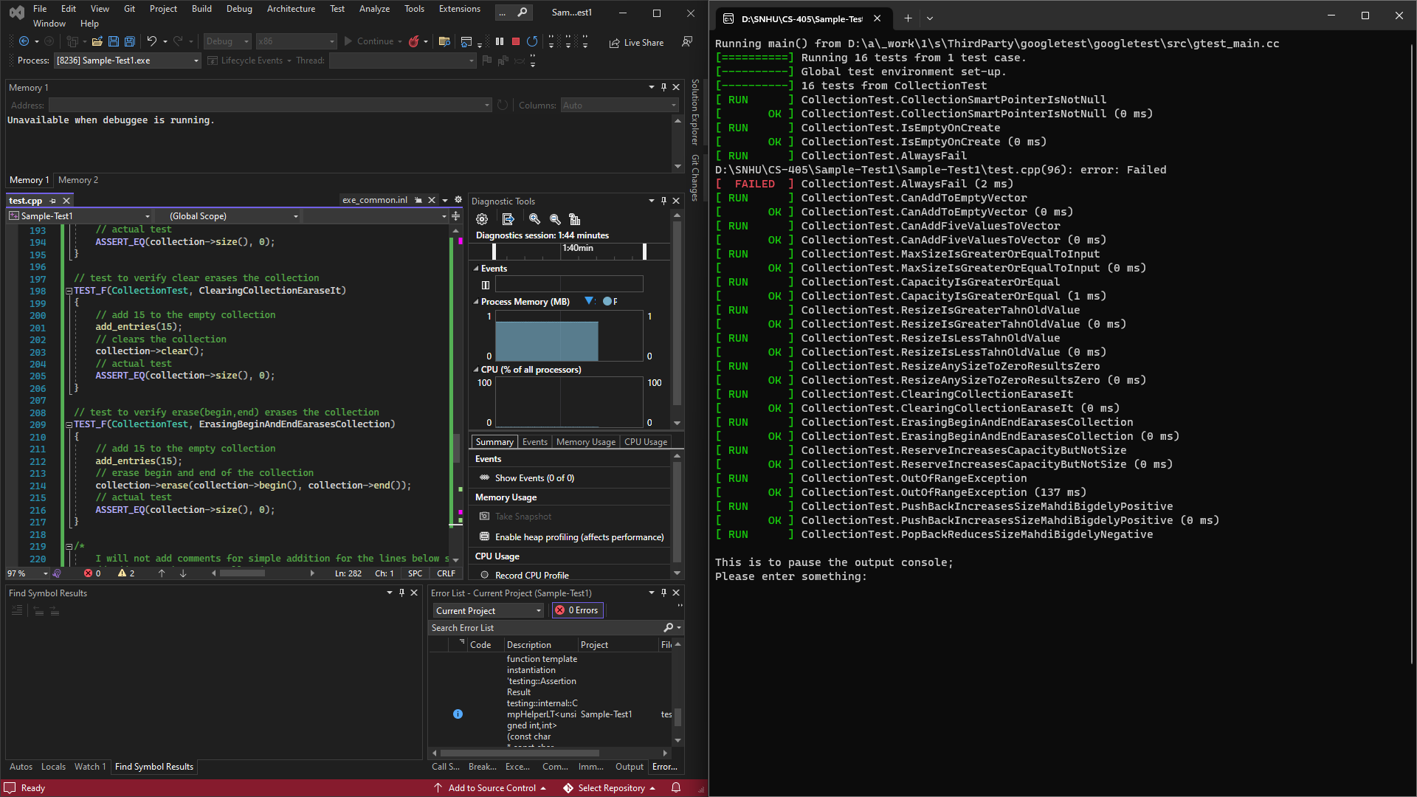
Unit Testing
As you can see on left, we built unit tests for a C++ collection class using the Google Test framework. These tests assess functionalities such as collection creation, checking for emptiness, resizing, clearing, and custom operations. The test suite encompasses positive and negative scenarios, following best practices with meaningful test names and validation of expected behaviors.
Notes:
Narration version: Unit testing ensures that individual parts of a software program work correctly, catching errors early and making it easier to maintain and improve the overall code quality.

Slide 9
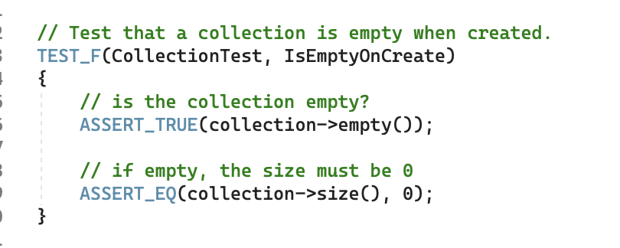
Unit Test: collection is empty upon creation

Slide 10
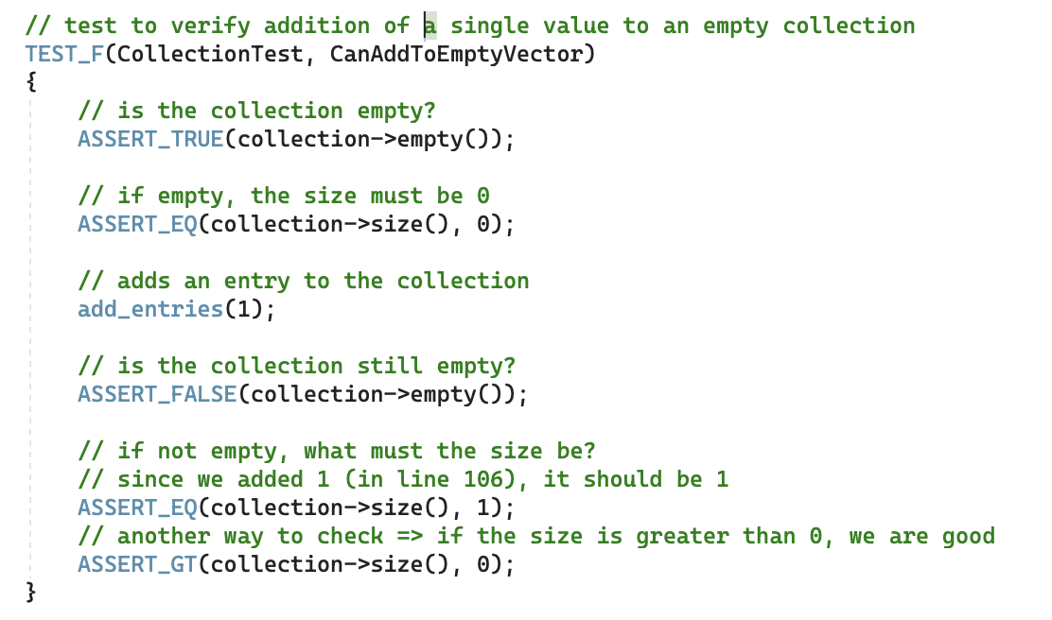
Unit Test: addition of single value to collection

Slide 11
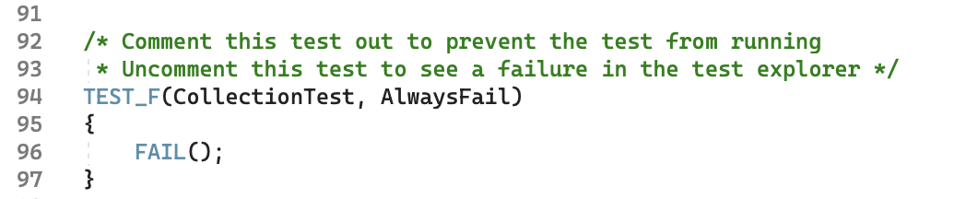
Unit Test: make sure fail test works

Slide 12
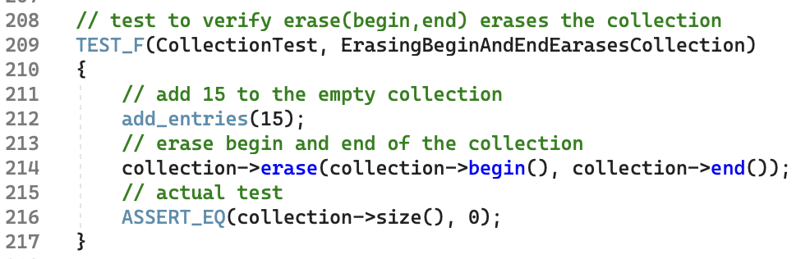
Unit Test: erasing start and end of collection, erases collection

Slide 13
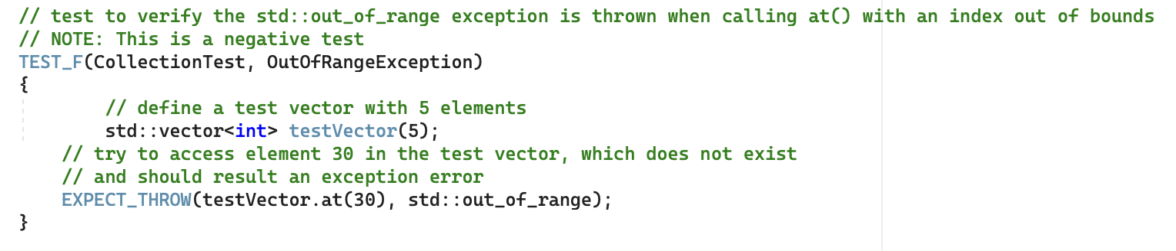
Unit Test: out of range value selection throws error

Slide 14

AUTOMATION SUMMARY
Notes:
Narration version: Automation is vital for making sure rules are followed in this policy and other DevOps processes. Using detailed processes and diagrams in DevOps, we will automate how these rules are followed. This makes things more efficient and consistent in how standards are applied throughout development and operations, and decreases human errors. By using automation, organizations can enforce policies and apply best practices consistently in the software development and deployment process. This aligns with DevOps principles, making development and operations work smoothly while following set standards.
Long Vesrion:
Automation will play a crucial role in ensuring the enforcement and adherence to the standards outlined in this policy, as well as other established DevOps processes and infrastructure. The implementation of automation mechanisms will be instrumental in streamlining and regulating compliance with the specified standards. To illustrate this, detailed DevOps processes and accompanying diagrams will be employed to automate the enforcement of the standards outlined in this policy. This approach aims to enhance efficiency, accuracy, and consistency in the application of standards throughout the development and operational lifecycle. By integrating automation into the DevOps framework, organizations can establish a robust and reliable mechanism for enforcing policies, ensuring that best practices are consistently applied across the entire software development and deployment pipeline. This proactive use of automation aligns with the principles of DevOps, fostering a seamless and efficient integration of development and operations while upholding the defined standards.

Slide 15
TOOLS
DevSecOps pipeline is an integrated and automated approach to software development that incorporates security practices throughout the entire development lifecycle by integrating security checks, scans, and tests at various stages, including code commits, builds, and deployments to address vulnerabilities early in the development process, fostering a more secure and resilient software application. Needs collaboration among development, operations, and security teams, aiming to deliver secure and high-quality software continuously.
Google Test framework, in addition to MS Visual Studio and C++ were used in this project
Notes:
Narration version: Tools in DevOps automation, like Git and Jenkins, boost efficiency by handling specific tasks in development and operations. They help manage code, automate testing, and ensure consistent deployment, fostering agile and collaborative development. Google Test framework, in addition to MS Visual Studio and C++ were used in this project
External tools play a vital role in DevOps automation by contributing specialized functionalities across various stages of the development and operations lifecycle. These tools are strategically integrated into the DevOps pipeline to enhance efficiency, collaboration, and automation. For instance, version control systems like Git are employed for source code management, ensuring seamless collaboration among development teams. Continuous integration tools such as Jenkins automate the build and testing processes, ensuring code quality and early issue detection. Configuration management tools like Ansible or Puppet enable the consistent deployment and management of infrastructure. Containerization tools like Docker provide a standardized environment for applications across different environments. Monitoring tools, such as Prometheus or Nagios, help track application performance and identify potential issues. Collectively, these external tools contribute to a comprehensive DevOps automation strategy, streamlining workflows and facilitating a more agile and collaborative development process.

Slide 16
RISKS AND BENEFITS
Coding poses inherent risks, demanding a resilient mindset recognizing perpetual threats. Establishing and adhering to a comprehensive baseline policy with defined standards, best practices, and continuous vigilance is crucial. A proactive stance involves ongoing education to stay abreast of security challenges, forming the linchpin of policy success.
For instance, Yahoo! 2013-2016 data breach exposed information of 3.1 billion users, due to a weak security policy (Improper Input validation)
Equipping developers with updated knowledge serves as a dynamic shield, empowering them to identify and address risks. The policy's effectiveness hinges on adaptability, continuous improvements, and assimilation of cutting-edge practices, ensuring robust defense against coding challenges and security threats.
Notes:
Narration version:
Coding comes with risks, so it's important to have a strong mindset and a good policy. Follow best practices and standards, keep learning, and stay updated to prevent issues and vulnerabilities. The policy's success relies on adapting and improving against coding challenges and security threats. For example, a security lapse (Improper Input Validation) led to the exposure of information for 3.1 billion Yahoo! users during the 2013-2016 data breach.
Coding poses inherent risks, demanding a resilient mindset recognizing perpetual threats. Establishing and adhering to a comprehensive baseline policy with defined standards, best practices, and continuous vigilance is crucial. A proactive stance involves ongoing education to stay abreast of security challenges, forming the linchpin of policy success. Equipping developers with updated knowledge serves as a dynamic shield, empowering them to identify and address risks. The policy's effectiveness hinges on adaptability, continuous improvements, and assimilation of cutting-edge practices, ensuring robust defense against coding challenges and security threats.
Longer version: Engaging in coding activities inherently exposes individuals to risks, given the formidable challenge of achieving absolute security. Developing a resilient approach necessitates cultivating a mindset that acknowledges the perpetual existence of threats and vulnerabilities in the dynamic landscape of coding. In response to these challenges, it becomes imperative to establish and adhere to a comprehensive baseline policy, incorporating well-defined standards, best practices, and a continuous commitment to awareness and vigilance. The cornerstone of this proactive stance involves the implementation of ongoing education initiatives. Developers should remain attuned to the latest security challenges, advancements, and methodologies, fostering a culture of continuous improvement. A robust policy, fortified by this commitment to education, emerges as a linchpin for success. By equipping developers with updated knowledge on security trends, the policy becomes a dynamic shield, empowering individuals to adeptly identify and address potential risks. In this ever-evolving landscape, the effectiveness of the policy hinges on its adaptability and receptiveness to emerging security trends. The integration of continuous improvements and the assimilation of cutting-edge practices not only bolster the policy's resilience but also contribute to its sustained efficacy. Thus, the proactive fusion of education, awareness, and ongoing enhancements becomes pivotal in fortifying the policy against the inherent challenges of coding, ensuring a robust defense against potential security threats.

Slide 17
RECOMMENDATIONS
To write secure code, follow best practices throughout the development lifecycle. Validate input data, heed compiler warnings, and prioritize simplicity. Adhere to the principle of least privilege, implement robust authentication, authorization, and access controls. Stay updated on security trends, embrace a defense-in-depth approach, and undergo thorough quality assurance testing. Regularly update dependencies, educate development teams on security, and maintain vigilant code and system monitoring for timely incident response.
Notes:
Narration version: Write secure code by validating input, heeding warnings, and prioritizing simplicity. Follow the principle of least privilege, use robust authentication, stay informed about security, and conduct thorough testing. Keep dependencies updated, educate teams on security, and monitor code and systems for timely incident response.
To write secure code, follow best practices throughout the development lifecycle. Validate input data, heed compiler warnings, and prioritize simplicity. Adhere to the principle of least privilege, implement robust authentication, authorization, and access controls. Stay updated on security trends, embrace a defense-in-depth approach, and undergo thorough quality assurance testing. Regularly update dependencies, educate development teams on security, and maintain vigilant code and system monitoring for timely incident response.
Larger version:
To write secure and safe code, it is crucial to follow best practices and adhere to established security principles throughout the software development lifecycle. Start by validating input data thoroughly, employing input sanitization techniques to prevent injection attacks. Heed compiler warnings, conduct code reviews, and prioritize simplicity to enhance code readability and maintainability. Adhere to the principle of least privilege, granting minimal access rights necessary for each user, system, or process. Implement robust authentication and authorization mechanisms, utilizing secure tokenization, two-step verification, and role-based access controls. Regularly update dependencies and libraries, stay informed about emerging threats, and continuously educate development teams on security practices. Embrace a defense-in-depth strategy, incorporating multiple layers of security measures, including firewalls, encryption, and intrusion detection systems. Lastly, undergo rigorous quality assurance testing, encompassing static and dynamic analysis, to identify and rectify security issues early in the development process. Regularly audit and monitor code and system activities, maintaining comprehensive logs for timely detection and response to security incidents.

Slide 18
CONCLUSIONS
In summary, this presentation outlines the essential principles and standards crucial for establishing and sustaining a secure and proficient programming environment. By incorporating these guidelines, we have comprehensively addressed key aspects to demonstrate our commitment to robust security practices. Notably, our adoption of a zero-trust policy emphasizes a stringent approach to access control both within and outside the company network. This strategy underscores our dedication to preserving security and privacy, ensuring the protection of sensitive information for all stakeholders. Our holistic approach aims to create a resilient programming framework that prioritizes confidentiality, integrity, and availability across all facets of our operations.
Notes:
Narration version: In short, this presentation covered important principles and standards for a secure programming environment. We are committed to robust security, adopting a strict zero-trust policy for access control. This ensures the security and privacy of sensitive information, creating a resilient framework by prioritizing confidentiality, integrity, and availability.
In summary, this presentation outlines the essential principles and standards crucial for establishing and sustaining a secure and proficient programming environment. By incorporating these guidelines, we have comprehensively addressed key aspects to demonstrate our commitment to robust security practices. Notably, our adoption of a zero-trust policy emphasizes a stringent approach to access control both within and outside the company network. This strategy underscores our dedication to preserving security and privacy, ensuring the protection of sensitive information for all stakeholders. Our holistic approach aims to create a resilient programming framework that prioritizes confidentiality, integrity, and availability across all facets of our operations.

Slide 19
REFERENCES
Magnusson, A. (2023, October 5). What is AAA Security? authentication, authorization, and accounting. StrongDM. https://www.strongdm.com/blog/aaa-security
Online, B. (2020, November 23). Yahoo Data Breach: What actually happened?. Medium. https://bpbonline.medium.com/yahoo-data-breach-what-actually-happened-54cf8f3f7c93
Rosencrance, L. (2022, November 22). What is DevSecOps?. IT Operations. https://www.techtarget.com/searchitoperations/definition/DevSecOps
Sei cert C++ coding standard. SEI CERT C++ Coding Standard - SEI CERT C++ Coding Standard - Confluence. (n.d.). https://wiki.sei.cmu.edu/confluence/pages/viewpage.action?pageId=88046682

